Slide 1

ActivePipe Contact Database Preparation
Notes:
Create different formats of contact preparation:
Short videos
Slide deck
Education.moxiworks.com course
Written HC articles

Slide 2

The importance of contacts
As real estate agents, you are in the people business. Contacts, whether they are leads, friends, old classmates, or coworkers, are all potential sales for you.
Our tools specialize in making sphere nurturing a breeze with our numerous automation and touchpoint functionalities.
With Moxi, the first hurdle you need to overcome is getting your contacts into your new CRM. Please review the next slides on how to prepare your contact databases for success!

Slide 3

Preparing your contacts for
CLICK HERE TO DOWNLOAD OUR REQUIRED CONTACT IMPORT TEMPLATE

Slide 4
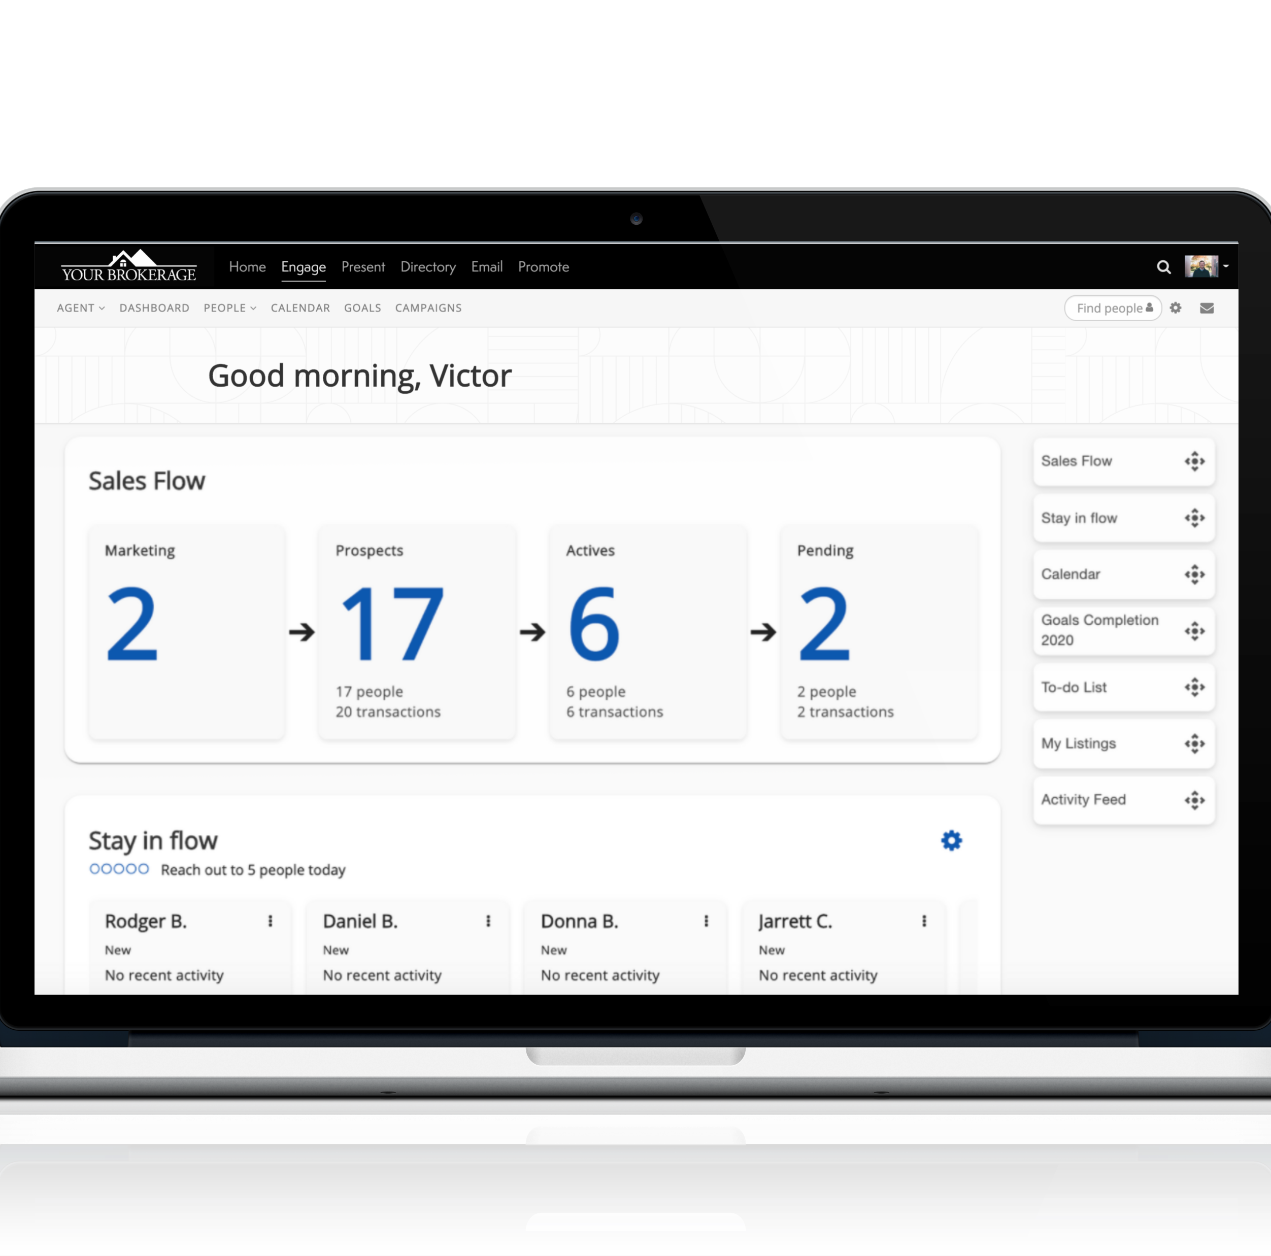
Why does MoxiEngage sync with your Email?
Syncing with your email to save you time and eliminate the need for multiple databases. This will take the hassle out of maintaining your database manually and focus on nurturing your contacts.
**You can ONLY SYNC with EITHER a WallaceTN.com email OR a free Gmail.
If you are NOT using WallaceTN or Gmail, you will not be able to sync, but you can still use ActivePipe directly inside your Engage account!

Slide 5











How Engage works with your email
Contacts & Calendar
ACTION
Contact Deleted
Contact NOT Deleted
If an agent’s Engage account is deleted, MoxiWorks does not retain any of their data.
ACTION
Contact IS Deleted
Contact Deleted
New Contact Added Contact Note Edit
Calendar Event Edit
New Contact Added Contact Note Edit
Calendar Event Edit
Notes:
Talk Track:
Moxiworks keeps it simple, and offers integrated solutions for the three key drivers that influence a real estate organization’s ability to scale.
Implementing integrated tech into your cycle of growth is how great brands continue to succeed and innovate.
When looking for a tech solution, look to something that streamlines, enables, or empowers success across all three focuses.
No matter where on this cycle you’re looking to make changes, MoxiWorks can help and even make the tools you already use for some of these areas more effective.
NOTES:
We want to show how integrated technology helps this cycle become more efficient.
These three areas of focus drive revenue and inspire innovation. But each of these goals can encompass many different problems and complexities.
Growing your brokerage can be recruiting new agents, strengthening retention, or even expanding to new offices and acquisitions.
That growth will motivate your agent community to be more productive in the market with added support and resources, including technology.
When agents increase their productivity, that drives a need for streamlined business operations - keeping all the gears turning.
When you find success balancing your back office operations you have momentum to grow your brokerage.

Slide 6
What information is synced from my email?
Contacts & Groups
  Upon your first log into MoxiEngage, ALL of your contacts in the main folder of your email's address book will be added.
Calendar
  Your calendar and MoxiEngage’s calendar will sync, giving you the ability to push any important reminders to your email’s calendar.
  Any existing calendar items will automatically sync to your MoxiEngage calendar and appear on your Dashboard.
  You can choose which tasks in MoxiEngage to add to your email calendar such as special dates, to-do items, appointments, etc.

Slide 7

Categorizing Contacts with Groups
Organize your contacts in MoxiEngage by creating Groups
In Gmail, Labels will create Groups in MoxiEngage.
In Outlook, Categories will create Groups in MoxiEngage.
You can create these groups in your CSV upload following these instructions: Can I add contacts to groups when I import them?
Any groups created in MoxiEngage will create a new label or category in your sync email address book.
Example groups: Mailing list, buyers, sellers, past clients, coffee friends, agents, open house leads, etc.

Slide 8
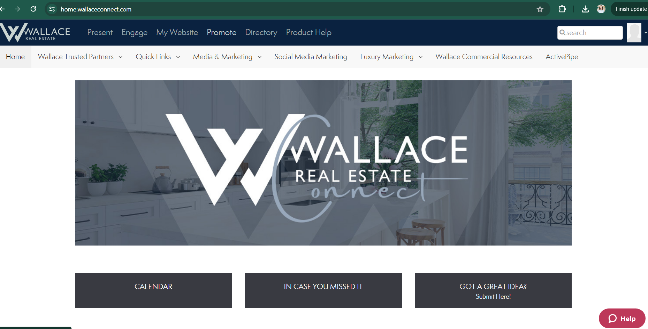
ActivePipe Initial Set-Up & Contact Sync
STEP 1: Sign into your Moxi account and you should find a new tab for "Active Pipe" in your menu bar.

Slide 9
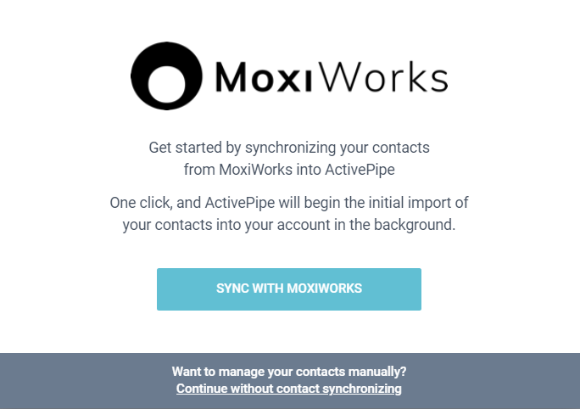
ActivePipe Initial Set-Up & Contact Sync
STEP 2: Click it, and you should see a screen like the one here.
STEP 3: Click the blue "Sync with Moxiworks" button to sync your current Engage contacts with ActivePipe.
STEP 4: Complete the next screen with terms and conditions.

Slide 10
Why Group Contacts in MoxiEngage?
*The way you group your contacts in Engage will flow over to ActivePipe.
*This is how we will know which of your contacts you'd like to receive which communication.
We will be sending 2 types of communication to begin.
Your Listings –
This will be an automated email that your SOI can receive an update anytime you list a property.
2. Monthly Newsletter –
This will be a newsletter, filled with relevant content (timely blog article, latest market stats, local events, etc) that your SOI can receive 1x per month (around the 10th of each month).

Slide 11
How to Group Contacts in MoxiEngage
To mark your clients to receive these communications, you will need to create TWO SEPARATE GROUPS in Engage, and add the clients to the groups.
The Listing group should be called WRE New Listing and the Newsletter group should be called WRE Client Newsletter.
*Please note that capitalization counts, so please name your groups exactly like they are listed here.

Slide 12
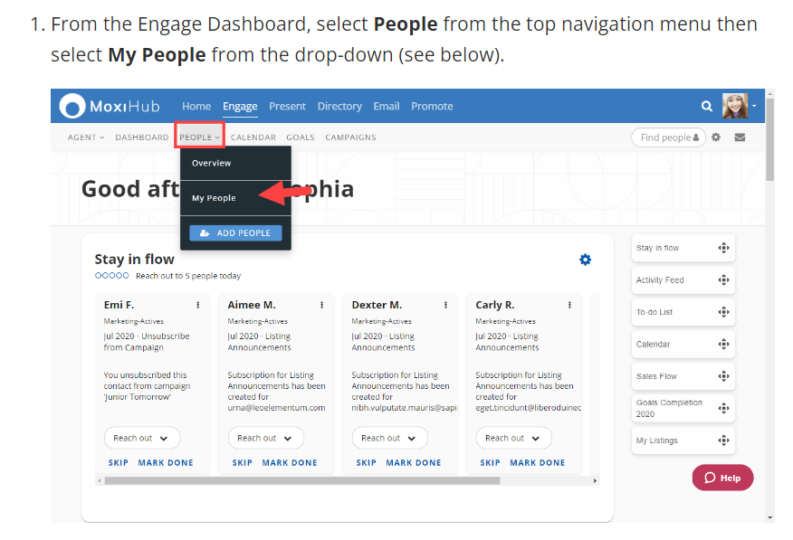
How to Create a New Group in MoxiEngage

Slide 13
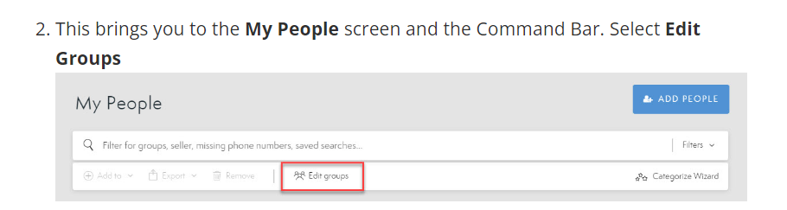
How to Create a New Group in MoxiEngage

Slide 14
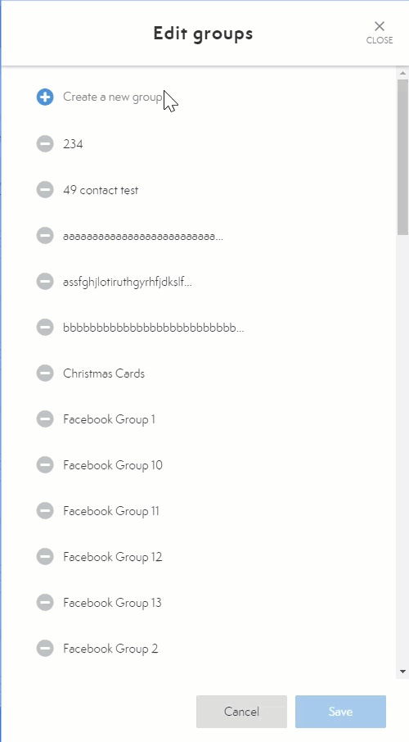
How to Create a New Group in MoxiEngage
Select the Create a new group field and enter the name of your client group
The Listing group should be called WRE New Listing
The Newsletter group should be called WRE Client Newsletter
*Please note that capitalization counts, so please name your groups exactly like they are listed here.
Make sure to click the Save button at the bottom of the window when you are finished.

Slide 15
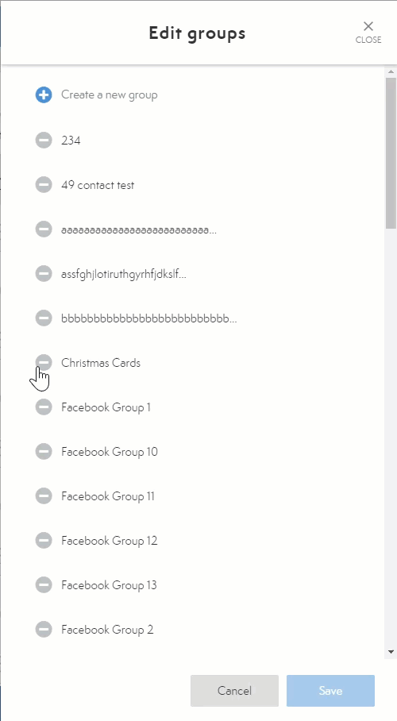
How to Delete a Group in MoxiEngage
To Delete a group, click on the Minus icon and choose Delete.
NOTE: Deleting a group will not delete individuals within that group.

Slide 16
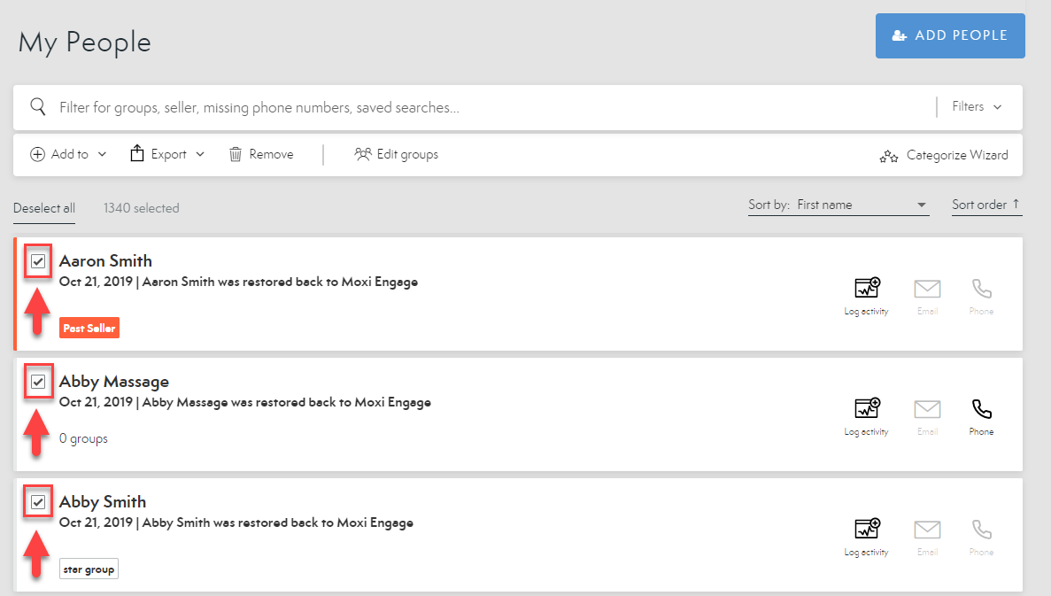
Add People to Groups – In Bulk
Quickly add as many contacts as needed to as many groups as desired by adding contacts in bulk!
From the
My People Screen, choose the contacts you wish to add to a group or groups by selecting the checkbox next to their names.

Slide 17

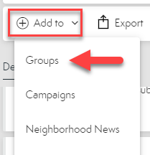
Add People to Groups – In Bulk
2. Select “Add To”
3. Select Groups

Slide 18
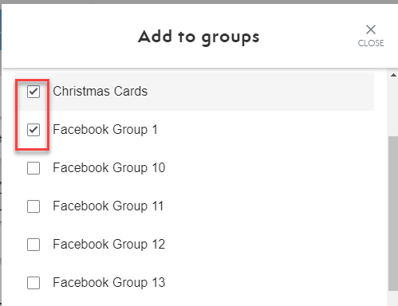
Add People to Groups – In Bulk
4. Choose all groups you wish to add the contacts to using the checkboxes.

Slide 19

Add People to Groups – In Bulk
5. Select Done at the bottom of the screen when finished.

Slide 20
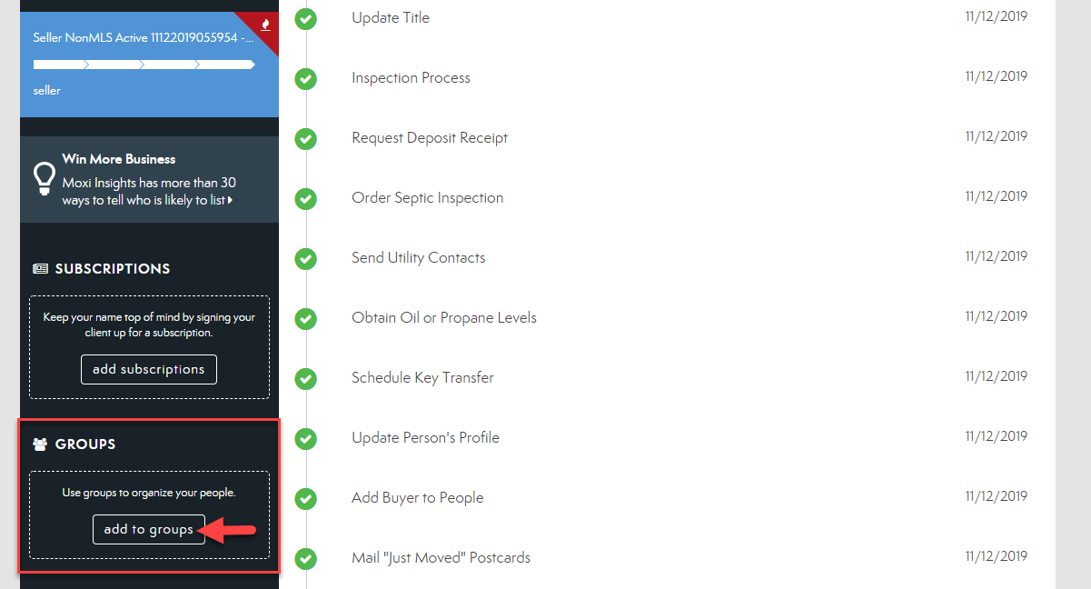
Add People to Groups – Individually from the Contact Card
You can add a single person to more than one group to easily manage your sphere and communicate with them.
1. From the client's contact card, choose Add to Group on the bottom left toolbar.

Slide 21
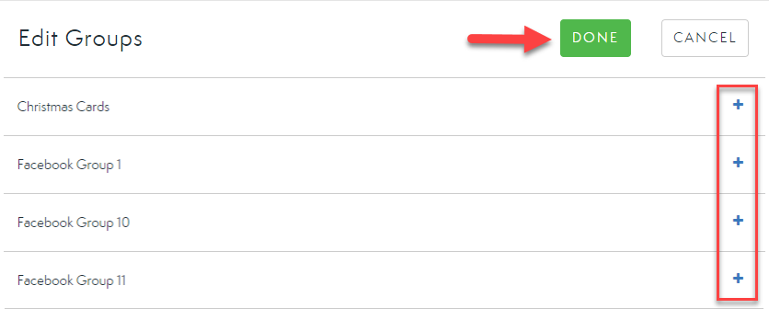
Add People to Groups – Individually from the Contact Card
2. Select the group(s) in which you would like this person to be included by selecting the Plus Icon.
3. Once you have chosen all desired groups, select Done.

Slide 22
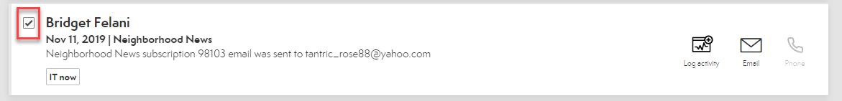
Add People to Groups – Individually from the My People Screen
From the My People Screen, choose the contact you wish to add to a group by selecting the checkbox next to their name.
2. Select Add To
3. Select Groups

Slide 23
Add People to Groups – Individually from the My People Screen
4. Choose all groups you wish to add the contact to using the checkboxes.
5. Select Done at the bottom of the screen when finished.

