Slide 1
Getting Started with
Social Media for Realtors

Slide 2
Agenda
Introduction to WRE Social Media
Setting Up a Facebook Business Page
Automating Your Social with Paradym
Collecting Reviews - Testimonial Tree

Slide 3


Slide 4
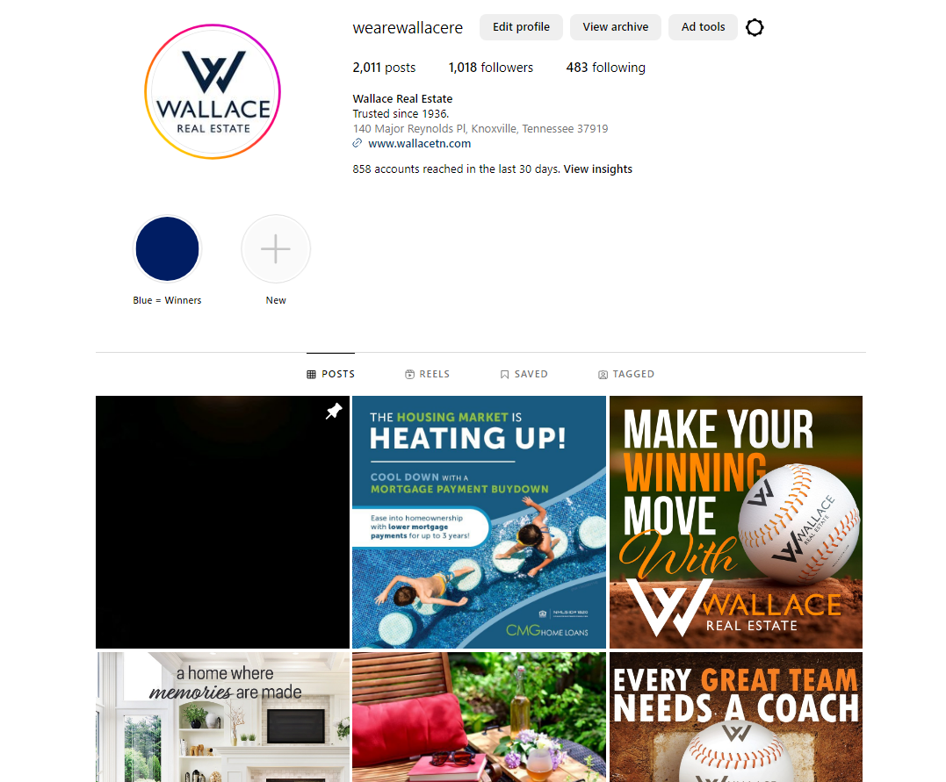
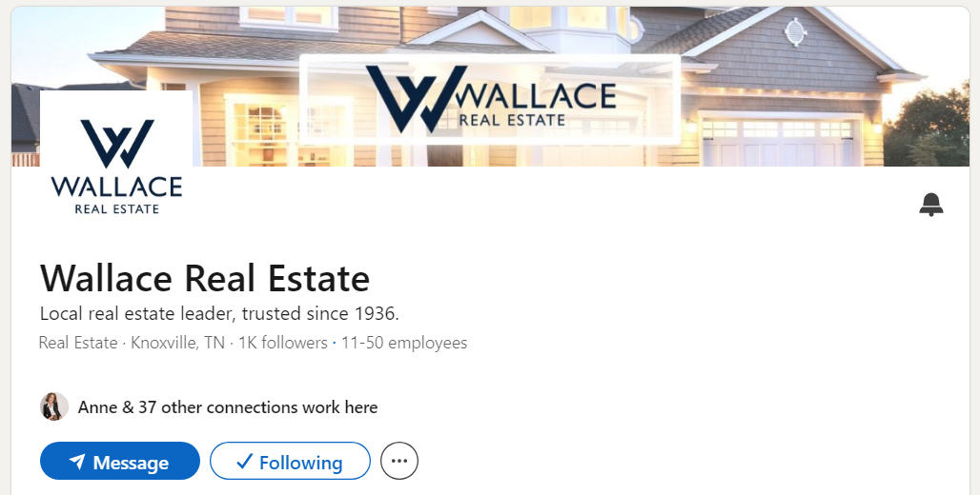
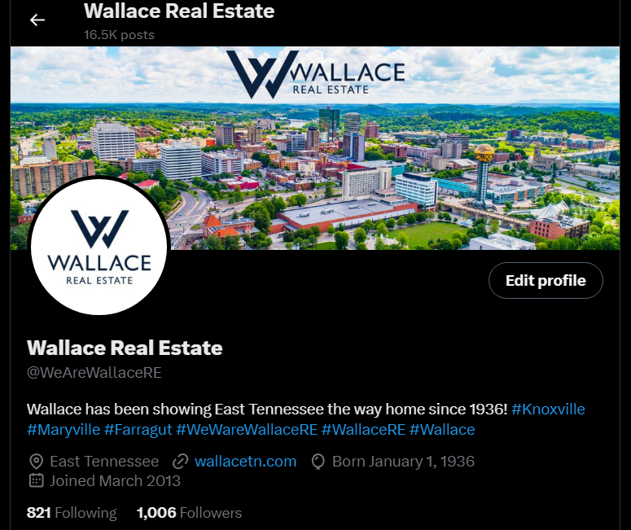
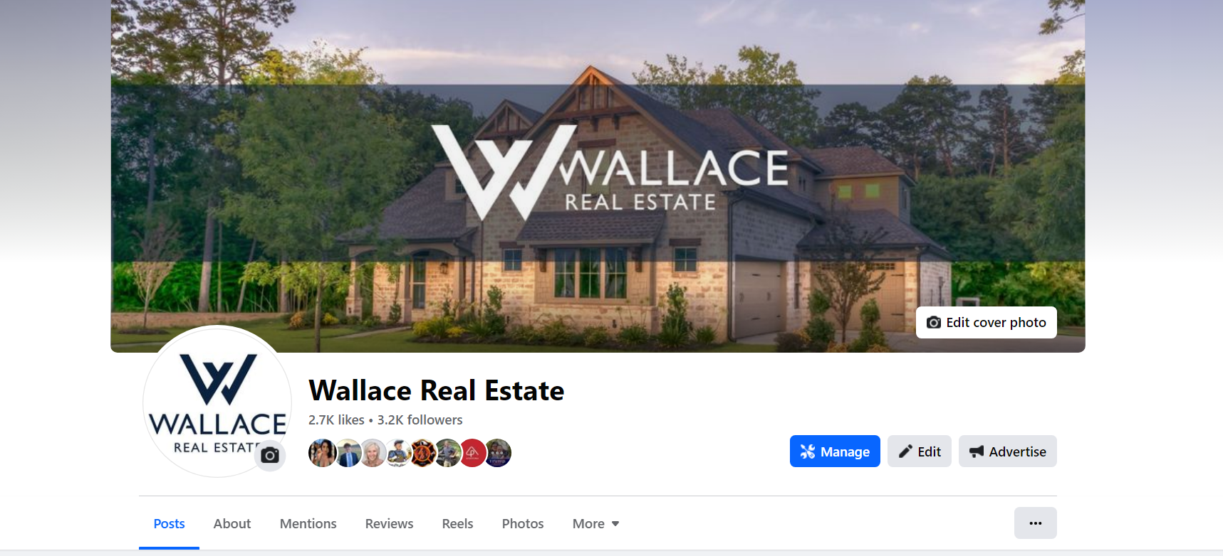

Slide 5
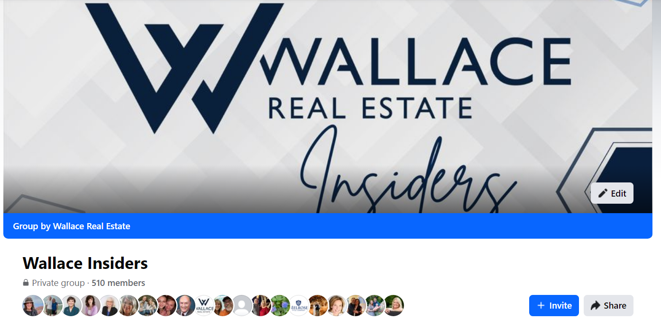

Slide 6
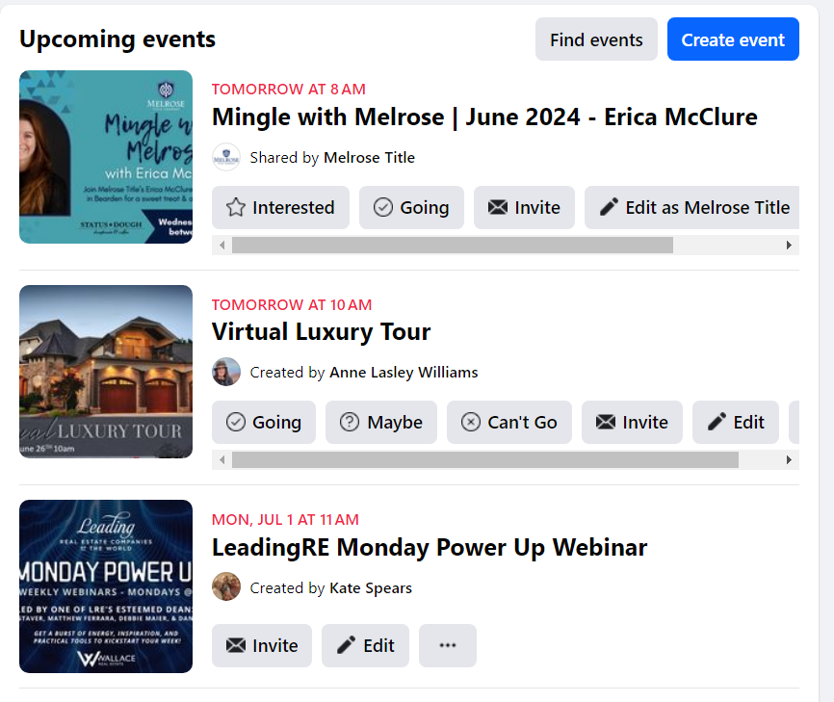

Slide 7
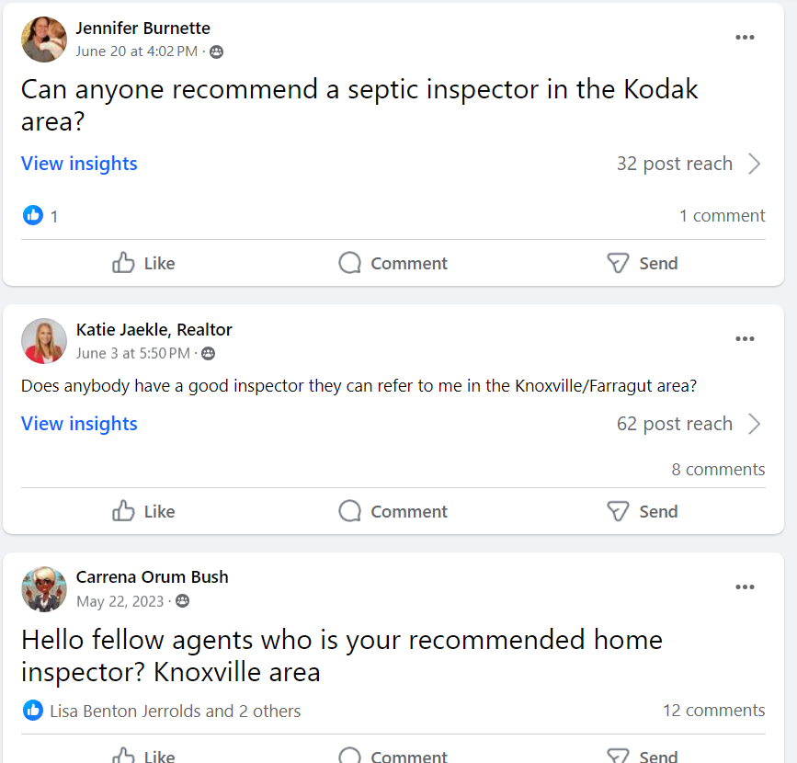

Slide 8
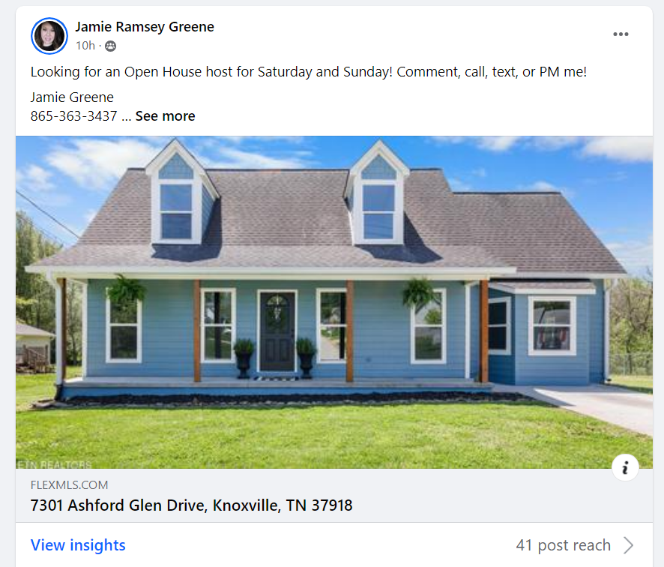

Slide 9
Setting Up a Business
Facebook Page

Slide 10
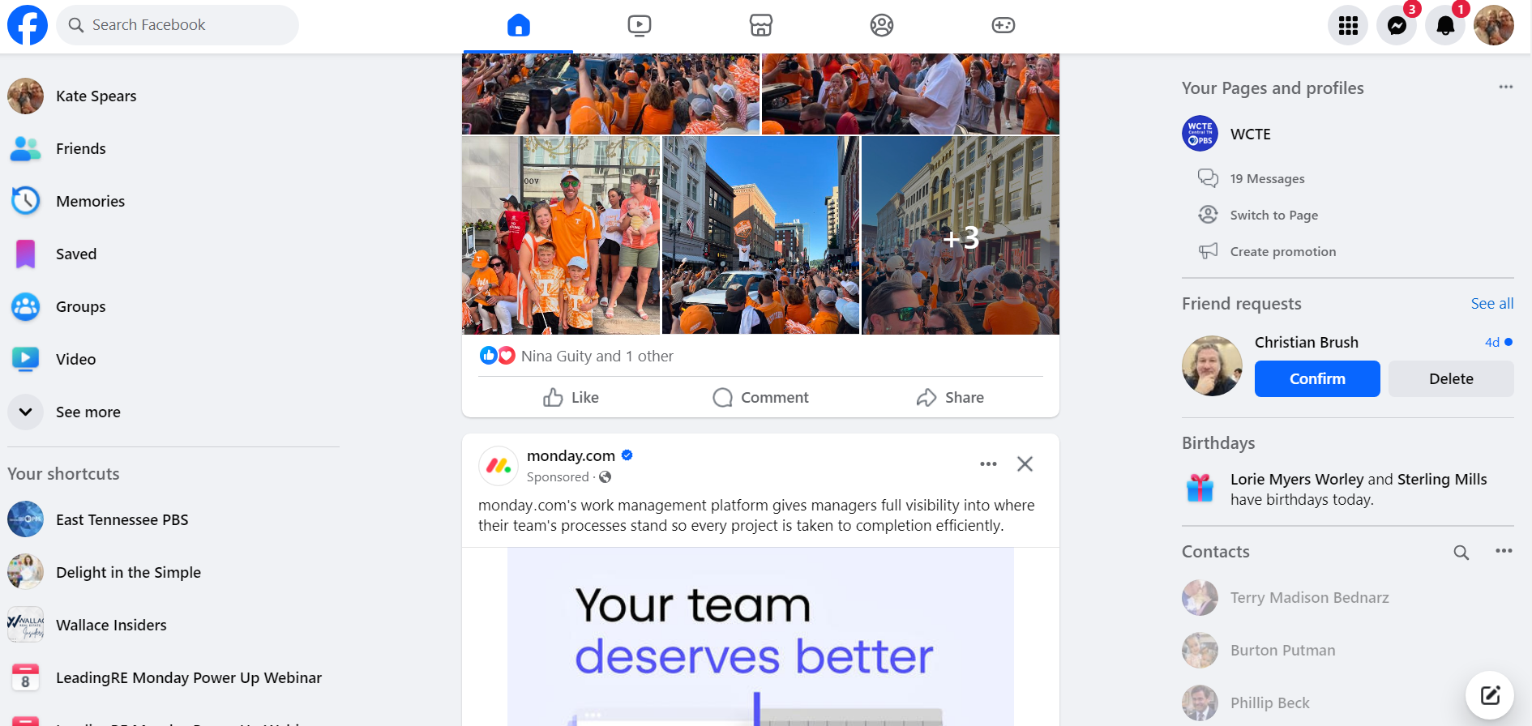

Slide 11
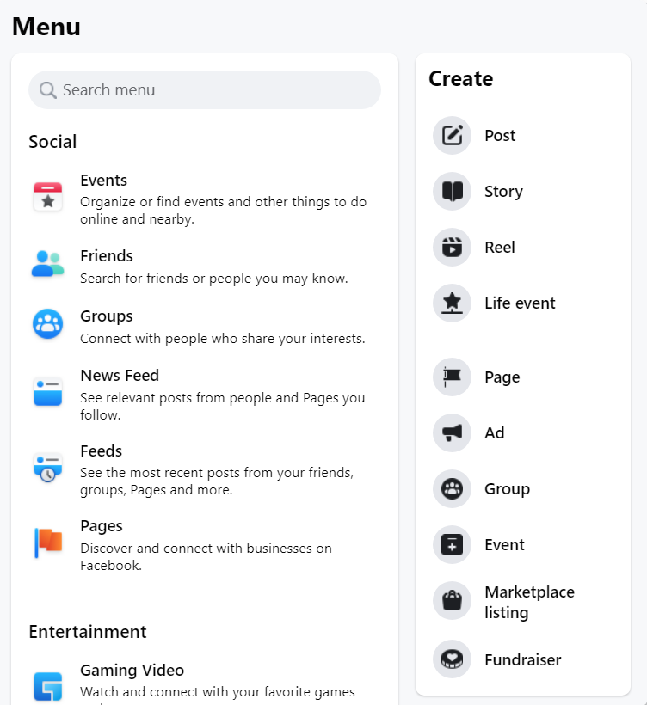

Slide 12
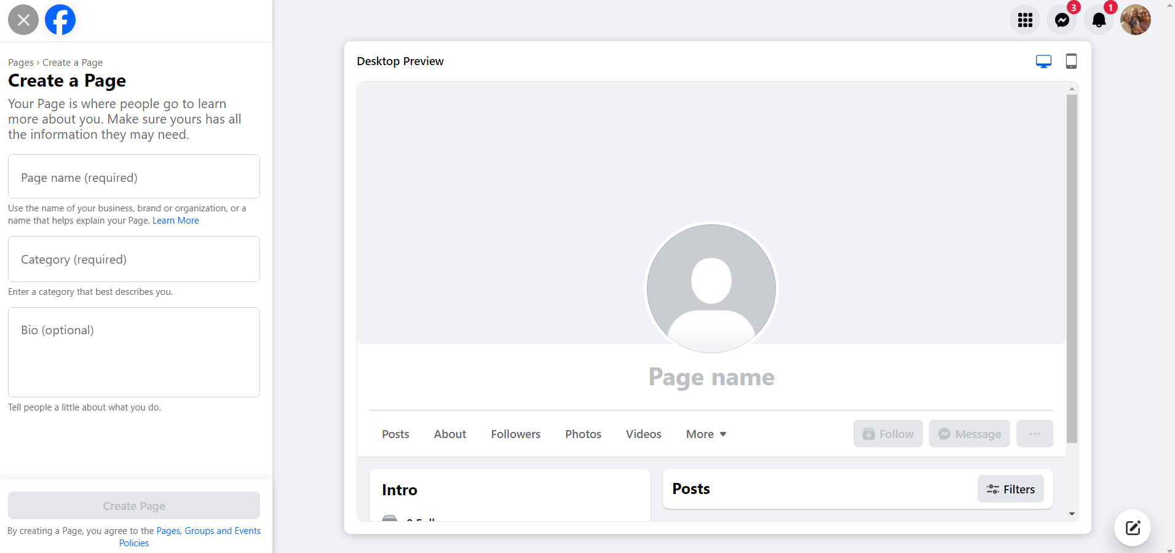

Slide 13
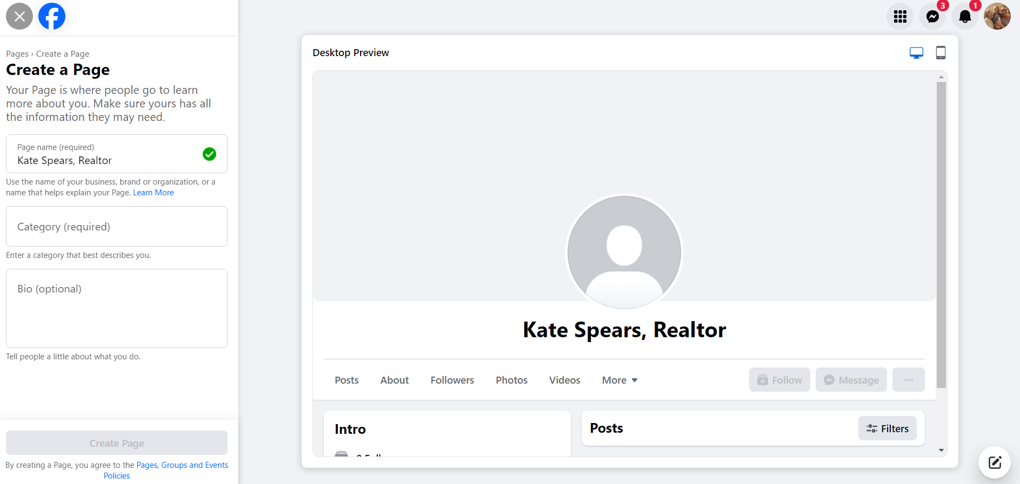

Slide 14
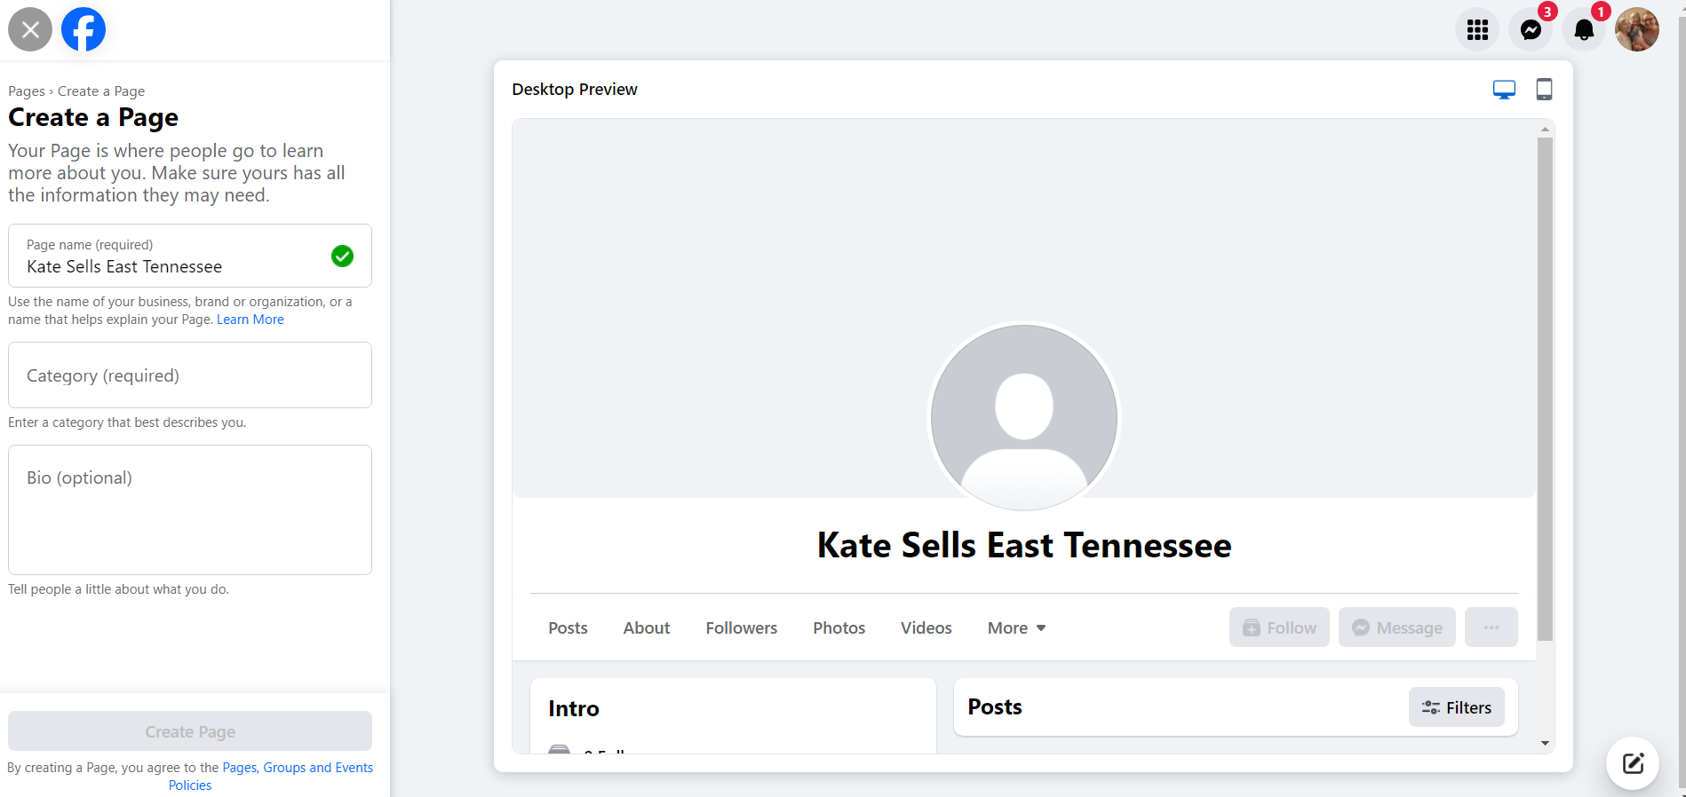

Slide 15
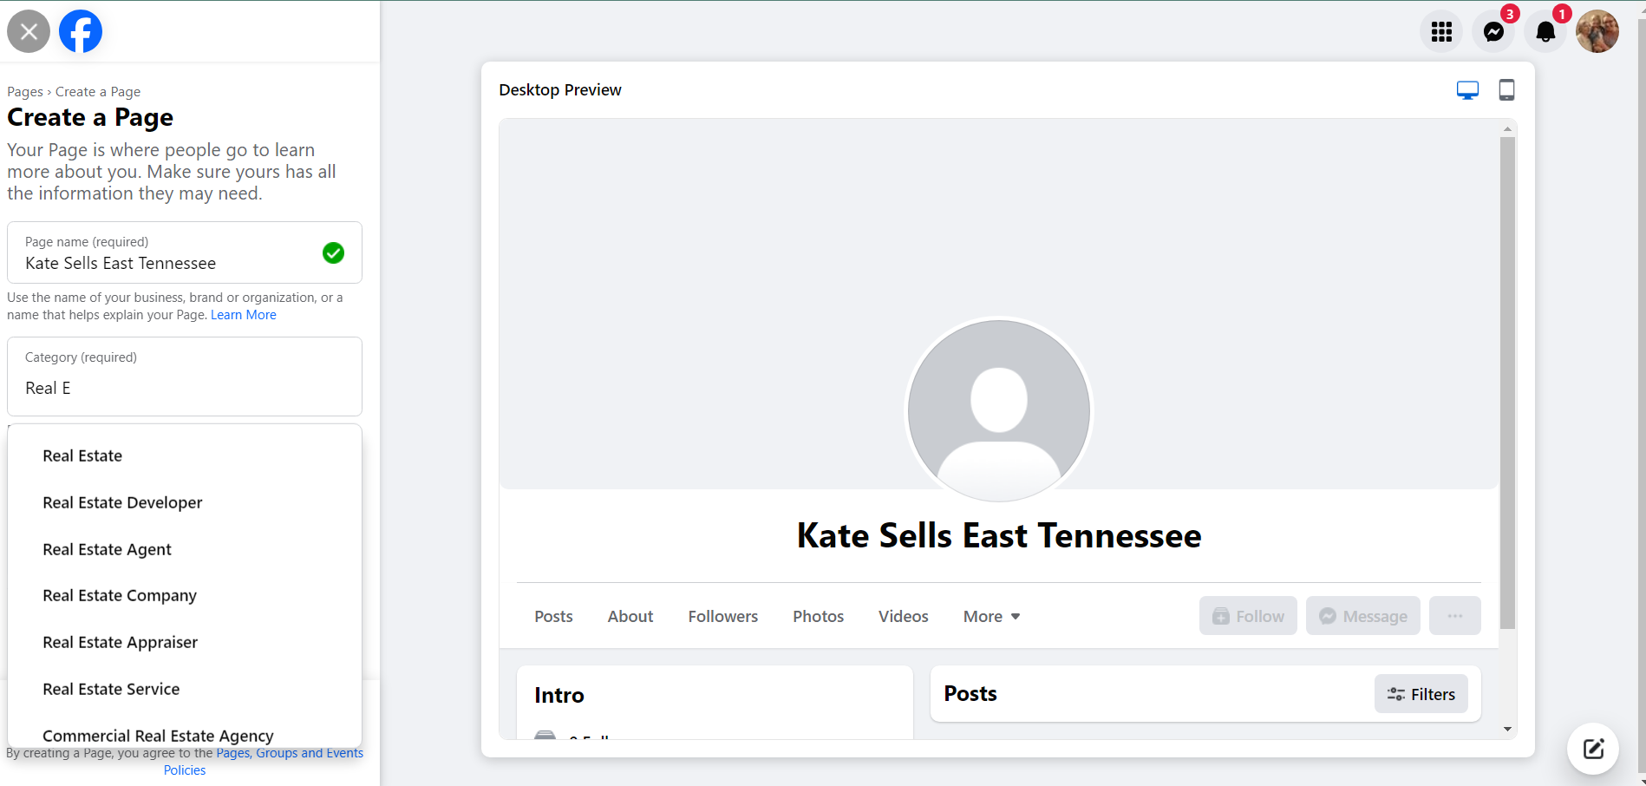

Slide 16
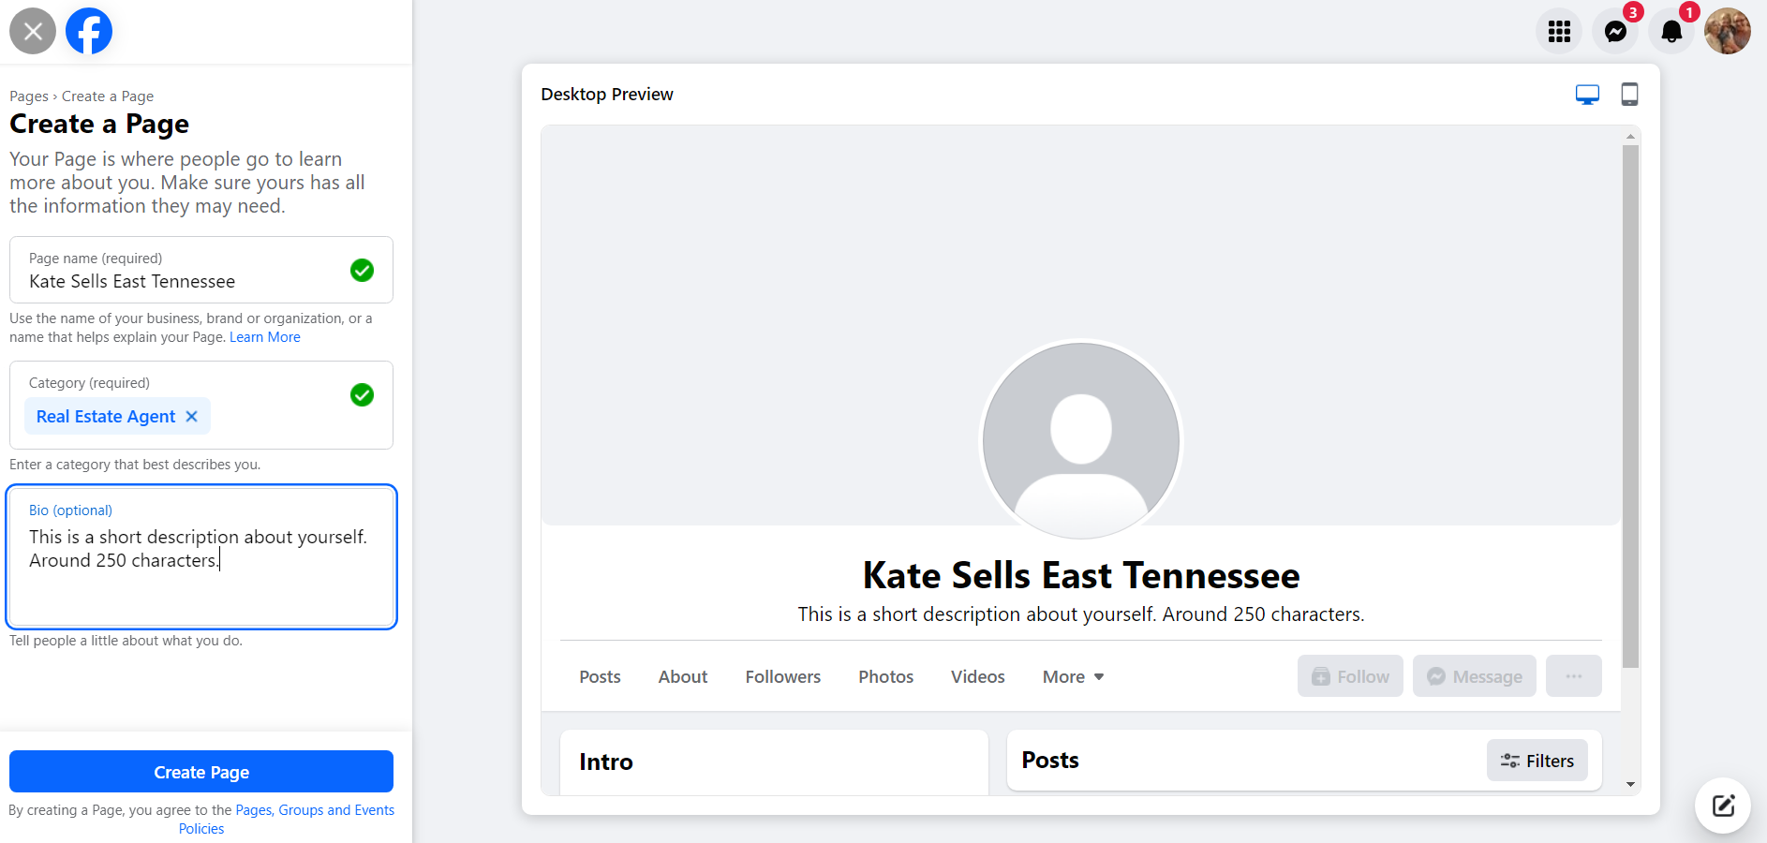

Slide 17
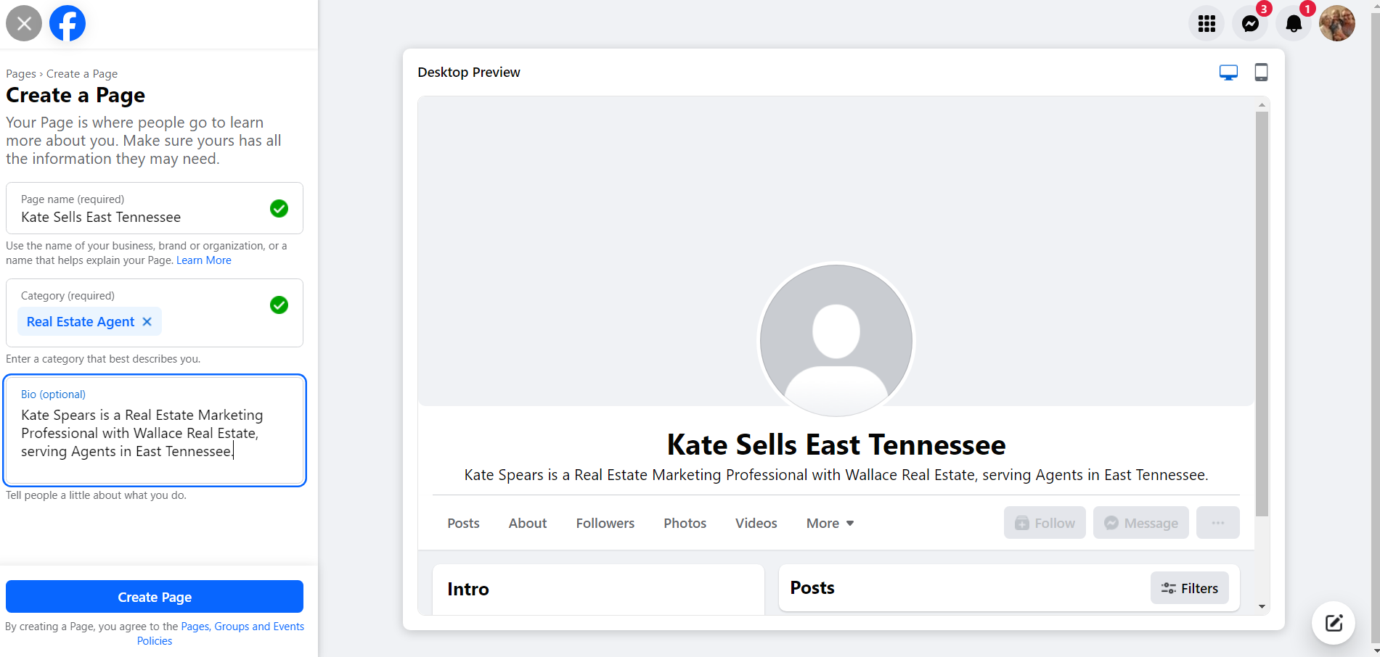

Slide 19
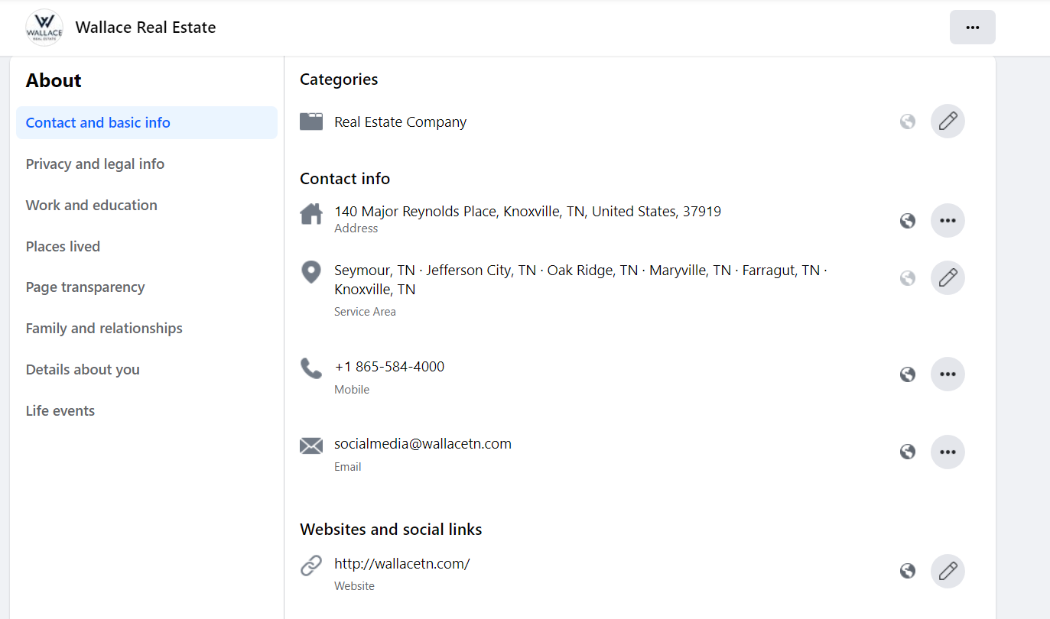

Slide 20
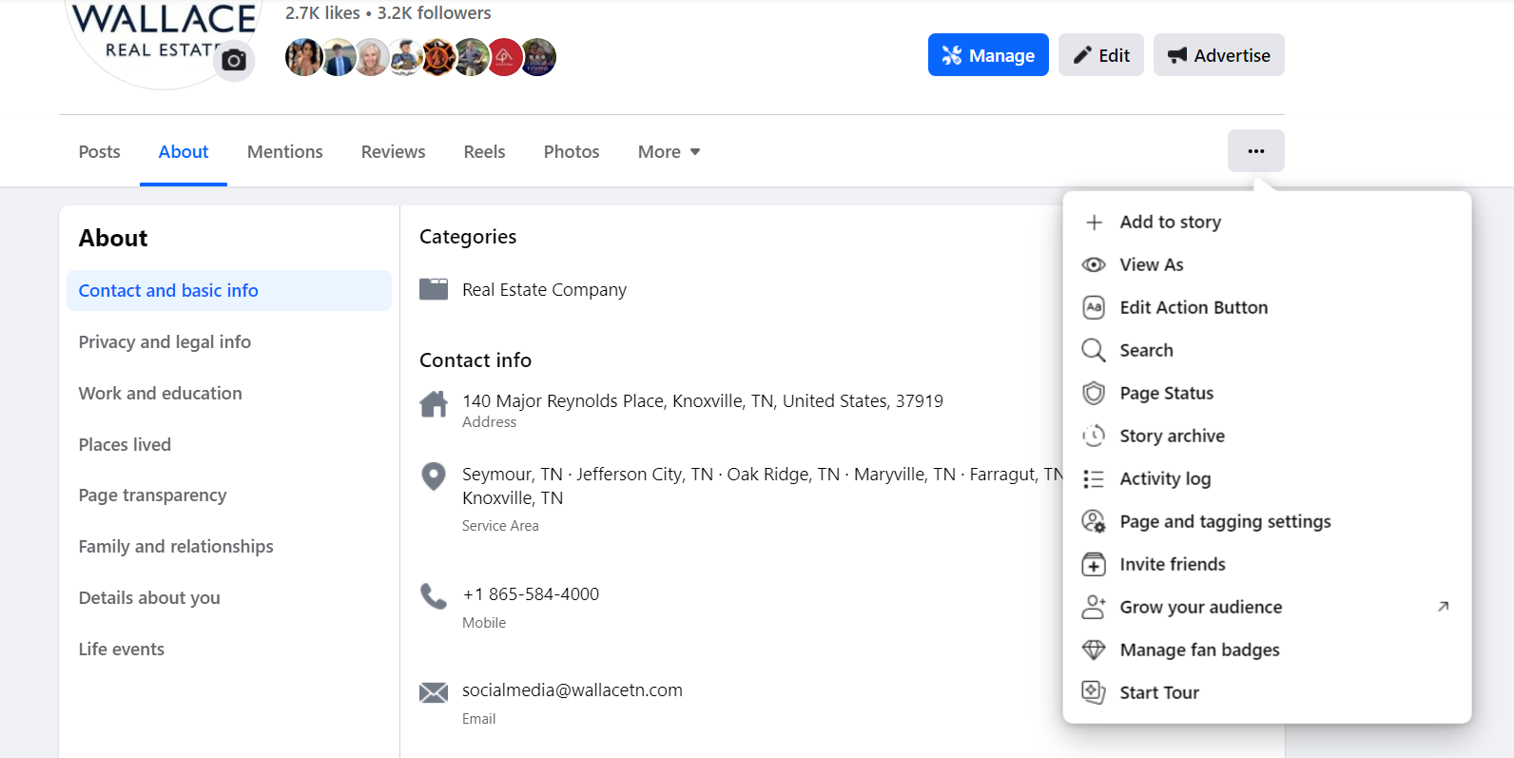

Slide 21
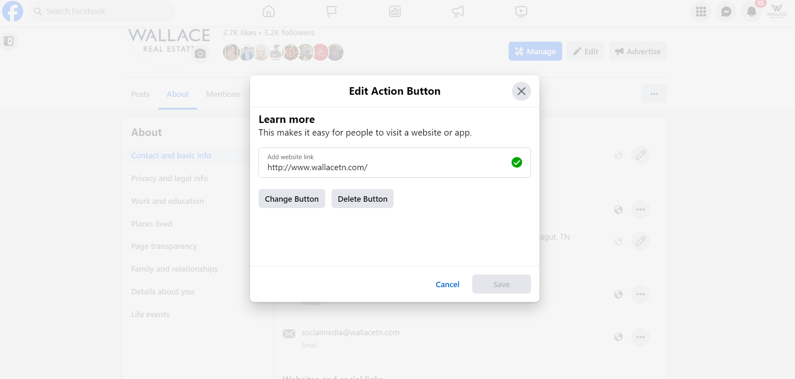

Slide 22
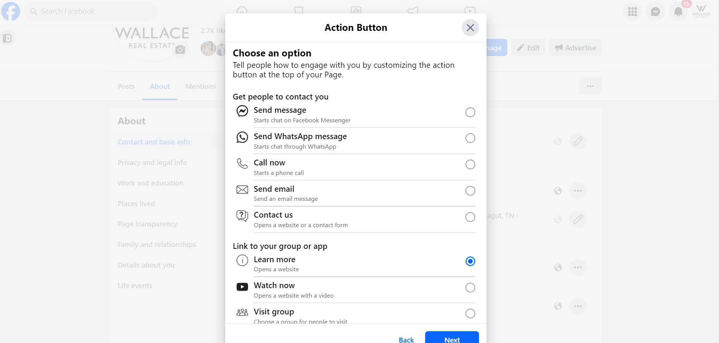

Slide 23
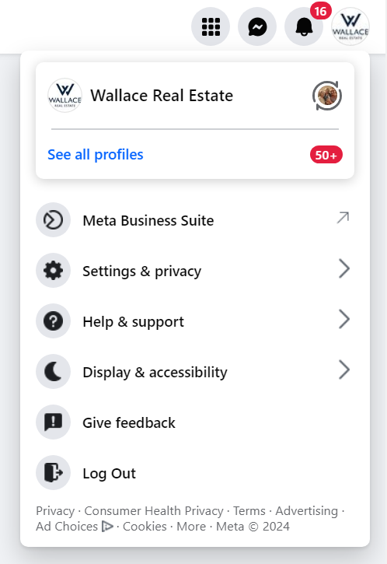

Slide 24
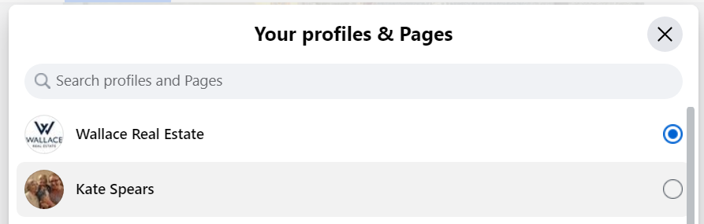

Slide 25
Other Best Practices
Have a Back-Up Admin (Trusted friend, spouse, partner, family member, etc)
Fill out every section thoroughly – this lets Facebook/Meta know your page is legit.
Ask a friend to visit your page and look at it objectively before you start sharing it out. Send it to me for review if you’d like! Kate@WallaceTN.com
Follow Wallace Social Media Platforms to share our content
Get 15-20 “Likes” so you can connect to Paradym for Automatic Posts!

Slide 26
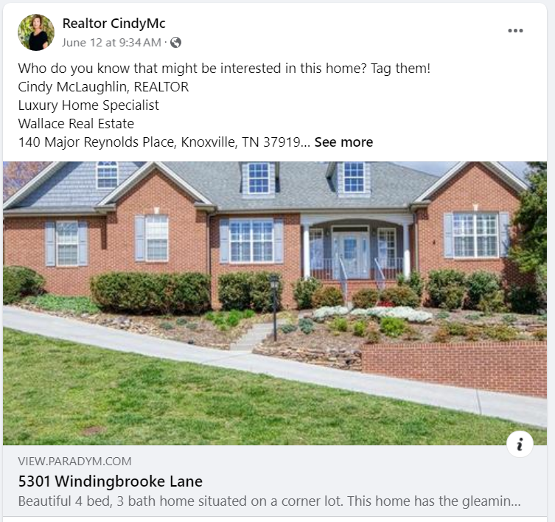
What does Paradym do for you?
Creates a Suite of Materials & Posts Your Listings to Social Media
(FB Page, Instagram, LinkedIn, & X)
Posts Other Wallace Properties to Social Media
(Based on Criteria You Choose – Price Range, Zip Code/Geographic Area)

Slide 27
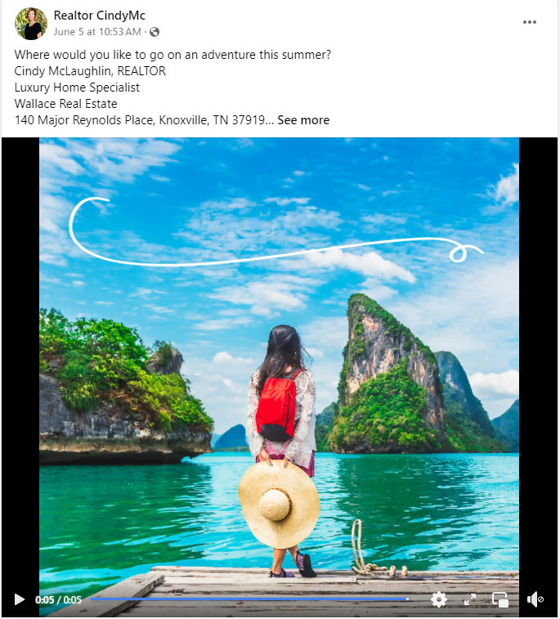
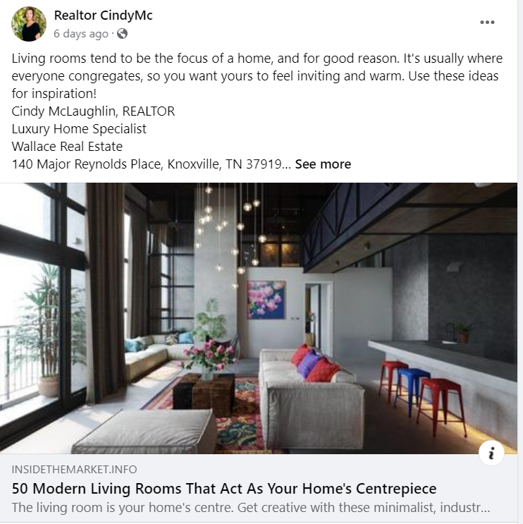
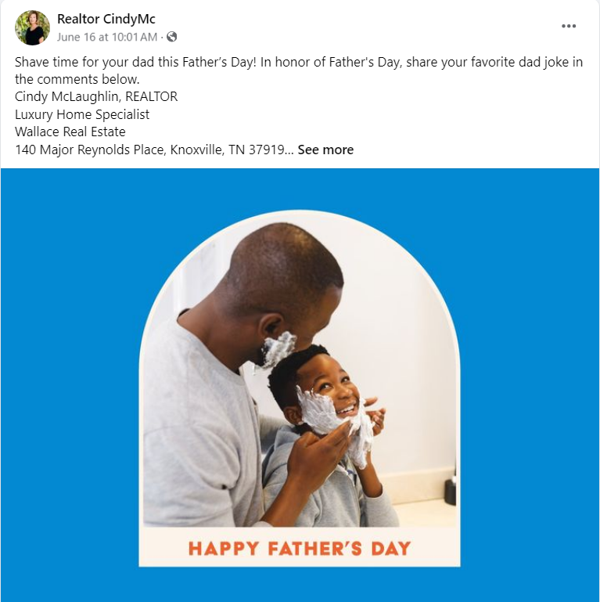
What does Paradym do for you?
3) Posts Blogs & Other Content (DIY, Travel, Gardening, Cooking, Tech – Categories You Select During Set-up)
4) Holiday Graphics Automatically on the Date of the Holiday (Based on a list of Holidays You Select During Set-up)

Slide 28
How to Get Started with Paradym
*Kate will create your Paradym Account
*Once you have gotten the required 15-20 Facebook Business Page Likes, you can connect your Paradym Account to your FB Page.
*Look for an email from Kate with additional details & an Email from Paradym containing your login credentials.

Slide 29

Collecting Client Reviews/Testimonials
Wallace offers our agents a platform called Testimonial Tree, which works behind the scenes to automatically request reviews from your clients when you have a closing.

Slide 30
How does Testimonial Tree Work?
You put your client’s email address into the SIP
Wallace’s Transaction Management Software, Skyslope, automatically triggers a request for a testimonial to be sent to that client after the property closes.
The client receives an email, and then fills out a quick survey giving the agent 1-5 Stars.
ONLY 4 & 5 Star Reviews are PUBLISHED. 1,2 & 3 Star Reviews are collected into a private Dashboard, and you get an alert. But nobody else sees them.

Slide 31
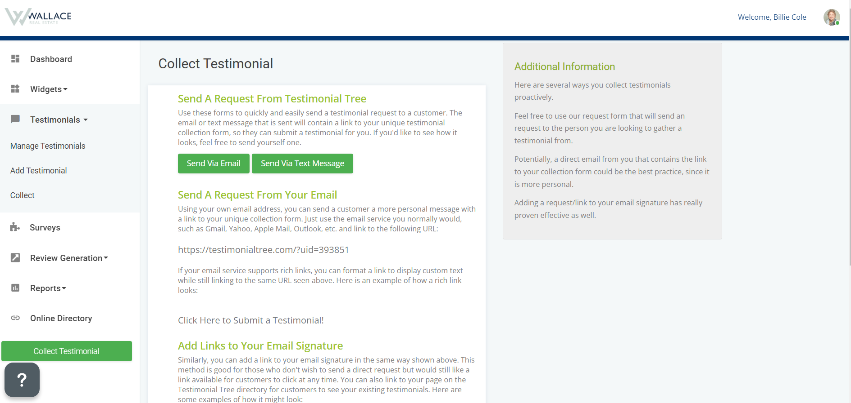
Can you get reviews other than from closings?
YES! Every agent has a unique link that can be found in your TT account. Simply share this link with anyone you know and they can give you a review.

Slide 32
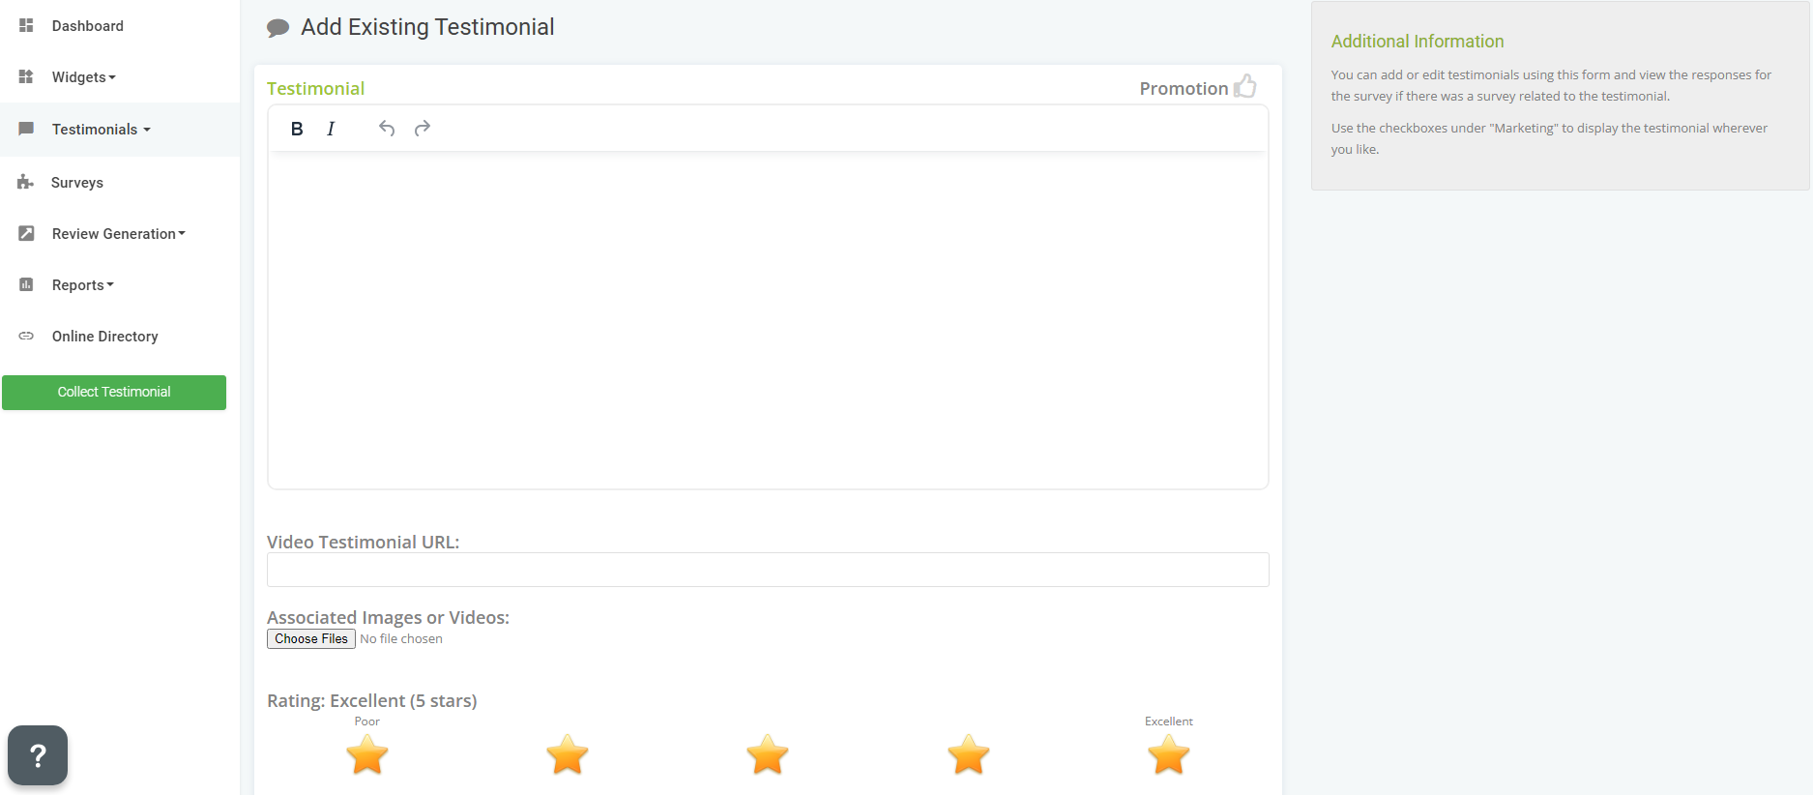
Can you get reviews other than from closings?
But what if I get a nice handwritten note from a client?
That can be added to TT manually, and turned into a review as well.

Slide 33
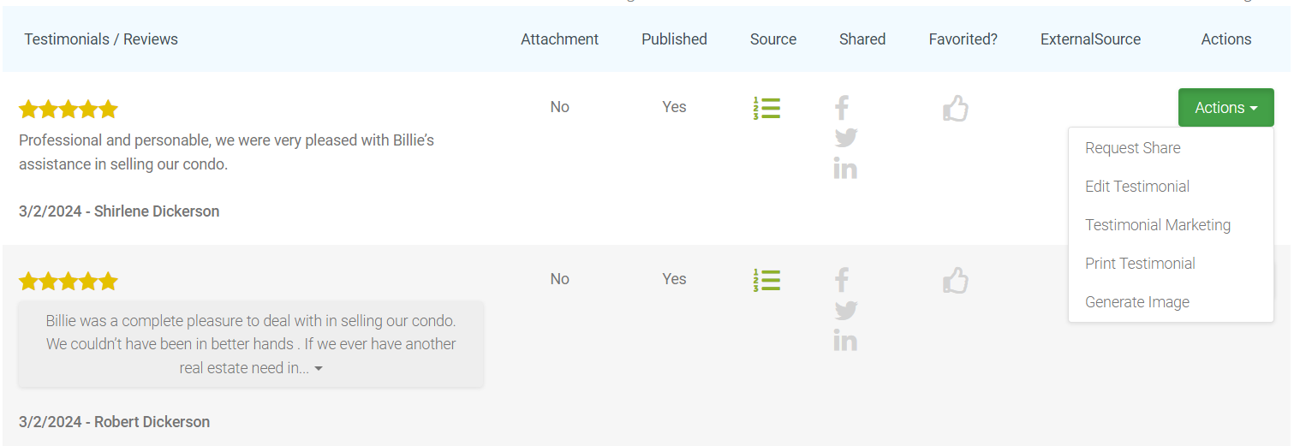
What if my client accidentally left a review with a typo?
Or includes something they didn’t mean to?
You can easily go into your TT account and edit the reviews in your dashboard.

Slide 34
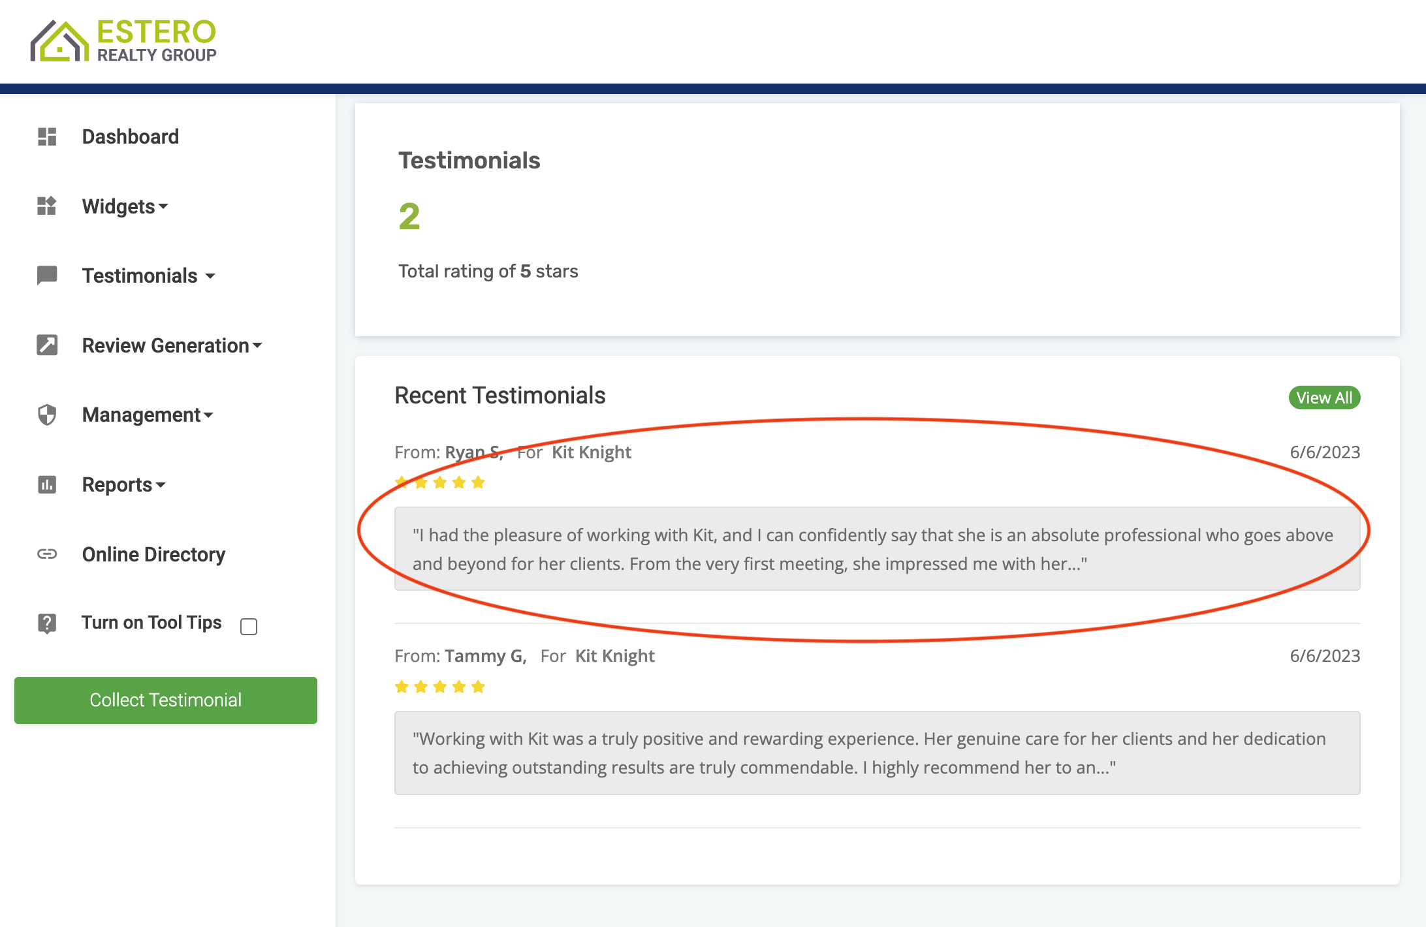
How can I use the reviews I collect in my Marketing?
You can turn any review in TT into a graphic to share in your marketing!

Slide 35
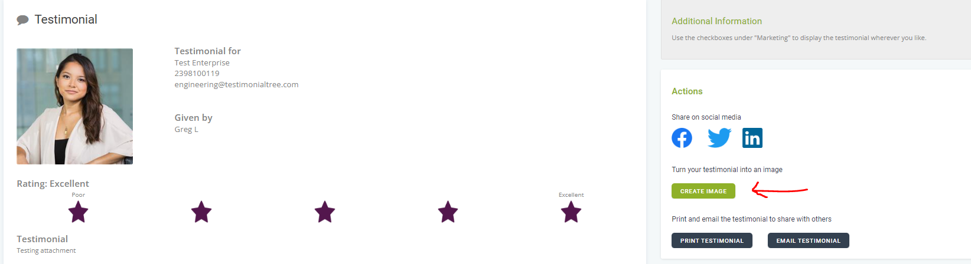
How can I use the reviews I collect in my Marketing?
You can turn any review in TT into a graphic to share in your marketing!

Slide 36
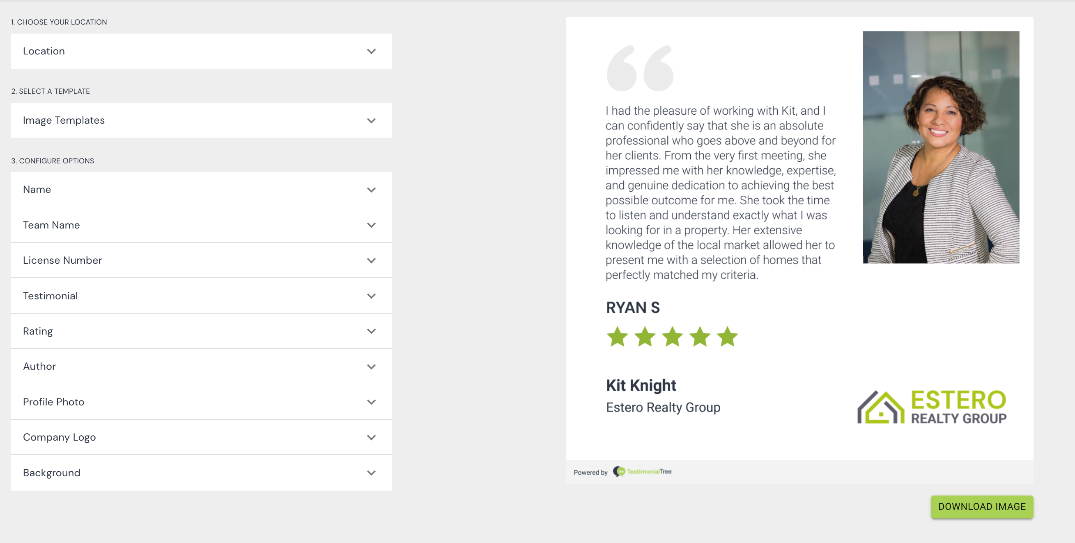
How can I use the reviews I collect in my Marketing?
You can turn any review in TT into a graphic to share in your marketing!
Click here for a step-by-step tutorial of this process.

Slide 37
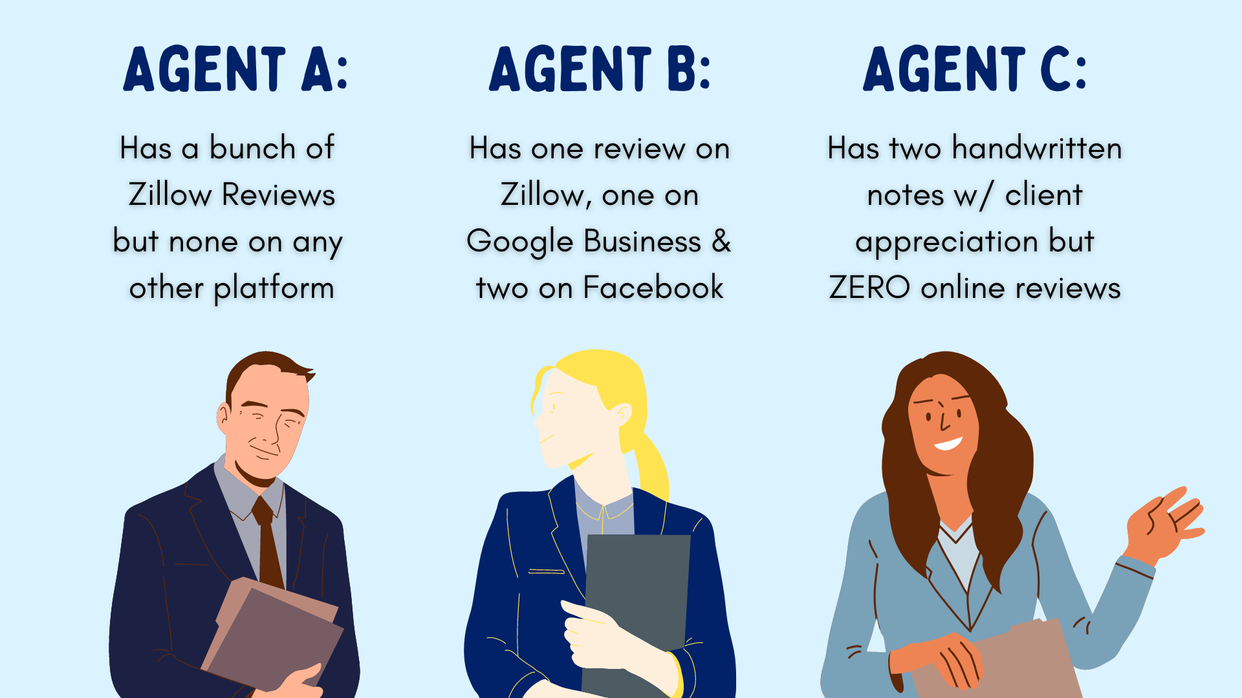

Slide 38
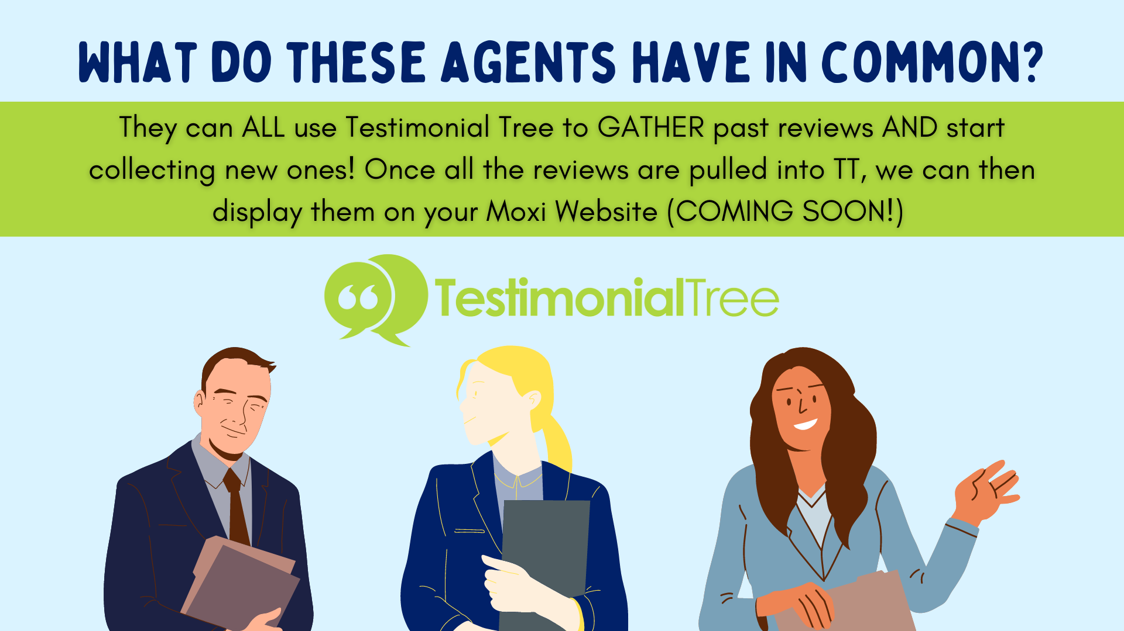

Slide 39
Questions?
Kate Spears
kate@wallacetn.com

