Slide 1

Mastering the Listing Consultation
Debbie Yankey
2021

Slide 2

I Have My License - Now What
It is time to PREPARE, HONE, and PRACTICE your Listing Consultation skills so you can be the best YOU!
Decide yourself if you are going to give 100% or are you prepared to give 110% - the market is saturated with competing agents
People do business with people they trust and like. If you win the Client, you win the listing.

Slide 3

Each Of You Will Perfect Your Own Presentation
No two houses are alike
No two people are alike
No two presentations will be alike

Slide 4
Decide What Your Storefront Looks Like
You are an Independent Contractor so decide what your Storefront will look like
What are you going to sell - The listing presentation is for selling YOU and what you have to offer
How will you present your merchandise – How will you dress for the listing appointment
How will you advertise – Get to know the products CBW provides from print to social media
How will you pay the bills – Have you set up systems, have you taken Launch, have you prepared
Don’t forget to stick to your values/morals – they will not allow you to fail
Prepare for the Grand Opening

Slide 5
Set Up Systems
Computer Folders for Each Listing
Pre-Listing Interview
Listing Packets
Listing Presentation
Resume
Marketing Plan
Follow-Up Plan

Slide 6
Build your presentation around these 3 points – Its what sellers most want to know
1) How are you going to sell my home?
2) How long will the process take?
3) What is it going to cost me?

Slide 7
Do I Have Everything – Gather what you need to take with you
Listing Presentation – Moxi Present Branded to You
Comps - CMA or RPR and prepare for Zillow’s Zestimate
KAAR MLS Stats – obtain from Claudia
TAR Listing Agreement and Disclosures – 2 Copies
Sample Marketing Binder or Flyers
Business Cards, Contractor List

Slide 8
Initial Contact/Phone Interview
“If it’s alright with you, I would like to ask you a few questions and then set up a time for us to get together. These questions will help me prepare for our meeting and should only take about 5 minutes.
May I ask who referred me to you?
When do you want or need to put your home on the market?
Will you be moving local or relocating out of town?
Why are you selling? Job related? Moving closer to family? Retiring?
Do you have a list of improvements made since you purchased?
Do you have a past appraisal, survey, dock permit?
If previously listed, what was your feedback?
Add to your list so you don’t forget to ask important, price-driven questions

Slide 9

Listing Consultation/In Person
The Listing Consultation is designed to help you get to know me, my Company, and the process of preparing, marketing and selling your home.
Our appointment should take approximately one hour, during which time we should accomplish the following:
Tour your home to discover the most marketable features
Review your goals and any concerns you may have
Discuss the current market conditions and how they may affect you
Discuss my unique marketing strategies to reach today’s buyers
Answer any questions you may have about hiring me to represent you in the sale of your home
Set the initial market position/price and timeline for your home
Finalize any paperwork

Slide 10

IT’S SHOWTIME
This Photo by Unknown Author is licensed under CC BY

Slide 11

You’ve Got This!
When you arrive, thank them for meeting with you
Ask to take a tour of their home and compliment them
Display Listing Presentation where all can see
Walk out with the Listing!

Slide 12
Setting the List Price
Compare similar homes that have sold
Evaluate the current market competition or active listings
Evaluate the home’s current condition and location
Find out if homeowner will make any repairs before listing
Determine desired selling timeline
Verify square footage

Slide 13
Pricing/Positioning
Price is the cornerstone of positioning. In my experience, a great percentage of your marketing strategy is set during the listing presentation when you and the seller agree on the right price and therefore the right market position for their home.
A property that is positioned well among its competition will always sell quicker and will net the seller a higher sales price.
Research shows the first 30 days of a new listing is the most important period. If the property is priced well, there will be a flurry of activity and the offers will often be at very close to the list price. In some cases, properties sell above the listed price because you draw enough traffic to create an environment of excitement and urgency with buyers who are making offers.

Slide 14
Ways to Determine Initial Market Price
Use Comparables and Absorption Rate
Use MLS – CMA function
Use RPR – Realtors Property Resource
Zillow Zestimate (Found on Tax Record Comparables tab)
Get an appraisal

Slide 15
Market Timing
Show KAAR MLS Market Statistics and Charts
School Schedule and Holidays can affect timing of putting a home on the market. When schools are out in June, typically the market heats up. November/December it can slow down a bit.
Understand basic supply and demand

Slide 16
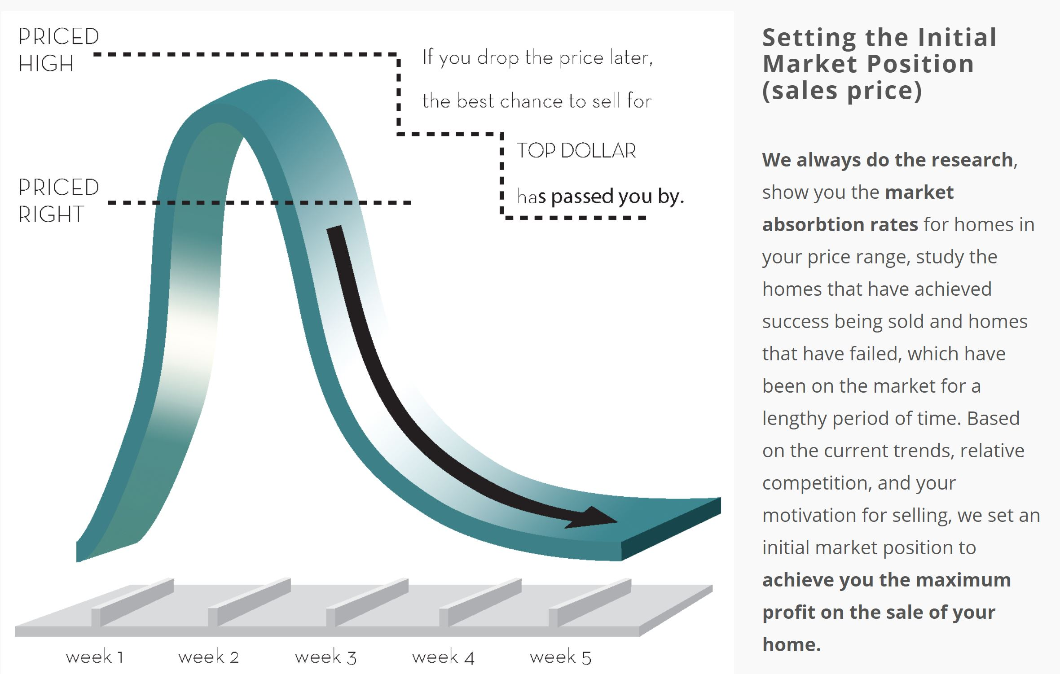
Absorption Rate

Slide 17
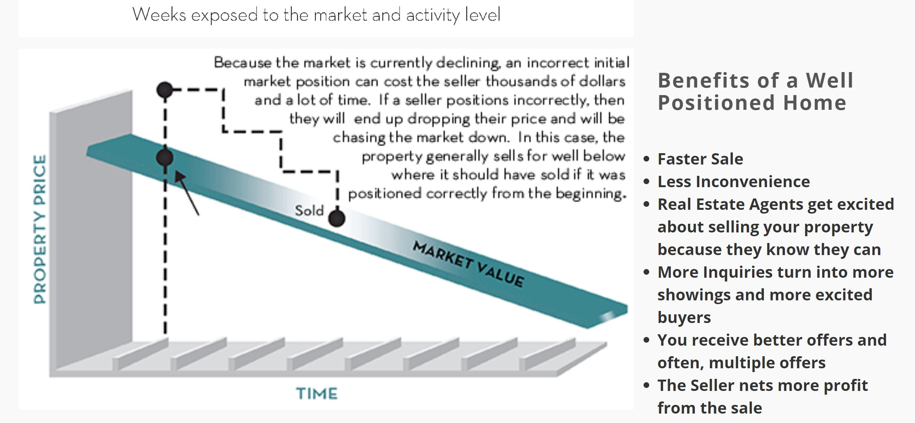
Benefit of a Well Positioned Home

Slide 18
Can We Try To Start High
Q: Couldn’t We Try Listing At Our Price For a Couple of Weeks?
A: If the initial price you want to list at agrees with the market research then the answer is yes. If your price defies all market research, then studies show you will lose time and money.
If you want the multitude of buyers to come and immediately disagree with you market positioning, you will lose their interest almost immediately. A common attitude with buyers in this situation is that they will wait to see if your home is still on the market in a few weeks or months and then maybe they’ll make a lowball offer.
Do you want to have your home “on the market” or “in the market” The home will sell faster for closer to list-to-sale price.

Slide 19
The Simple Truth About Overpricing
The property that offers the most value for the least expense will get the attention of the buyers and will receive offers.
It is best to position your house right at the desired sales price and be firm on negotiations. Building in negotiating room can often deter buyers from making an offer or bring in “lowball” unrealistic offers.
You lose a strong position both mentally and financially when your house is “stale” and has been on the market for a long time. Buyers often think something is “wrong” with the property or that it is priced too high.
Overpricing your home will help the competition because agents will show your home first and will then take the buyer to the correctly priced property and show them what a “deal” it is.
Let’s face it, having potential buyers parade through your home for months on end is no fun at all. Consider the time and energy it takes to prepare your home for showings, keep the property clean, make arrangements to leave while it is being shown, and stay by your phone to receive appointments.

Slide 20
Price Increment
$325,000
$300,000
$350,000

Slide 21
Marketing Plan – 1 of 3
Pre-Listing Consultation
Discuss market price and timeline
Discuss home preparation and required repairs
Obtain home’s features and highlights for marketing purposes
Discuss security, access requirements
Review listing documents and disclosures

Slide 22
Marketing Plan – 2 of 3
Listing and Marketing
Schedule professional photographer for interior, exterior, and grounds
Schedule drone photography footage or Matterport
Schedule videographer for custom video tour of interior, exterior
Measure all rooms
Place in Multiple Listing Service uploading photos and video
Create advertising for social media platforms such as Facebook, Instagram, CBW’s Luxury Website, Pinterest, Twitter, Adwerx, Paradym, etc.

Slide 23
Marketing Plan – 3 of 3
Steps to Sale
Qualify buyers and present offers
Negotiate sales contract terms
Secure all appropriate signatures on contract documents
Negotiate home inspection repair requests
Finalize all contract contingencies by the deadline dates
Monitor flow of transaction details with Lender, Title Company, and others
Coordinate final walk-thru
Review closings documents for accuracy
Attend closing to represent the seller

Slide 24
ShowingTime
Take either a lockbox or a picture and explain now their home is covered by a 24/7 staff that takes and sets up all showing appointments.
Explain its secure features
Explain how it automatically emails the buyer’s agent to request feedback

Slide 25
Commission – What Do You Charge
The Sellers are paying not just for the sale of their home, but for the knowledge and experience to navigate through the selling process.
It may seem easy to sell homes but getting that home to closing with all the challenges is hard to do. There are a lot of moving parts and numerous people involved in the transaction. The job of the real estate agent is to coordinate so closing happens on time.
Negotiating home inspection requests and/or repairs
Making sure the appraiser gets to the house and providing the necessary comparables so the home appraises adequately
Staying in touch with the lender to ensure they have received all the required documentation
Working with the Title Company to resolve any title issues

Slide 26
Will You Cut Your Commission
Arm yourself with a premier marketing plan
Compare commission listed on MLS Briefs on competing listings
Show the stats on how CBW compares to KAAR or other competing Agencies
Discuss CBW’s in-house Marketing and Advertising Departments
Discuss what CBW has to offer like internet lead routing system, virtual tours, YouTube Channel, website marketing (CBW, Zillow, Realtor.com, etc.)
Discuss CBW’s Relocation Department benefits and its Corporation connections
Just say “No” works sometimes
Discuss how commission is split

Slide 27
It’s A Wrap
Limit your presentation to 1 to 2 hours
Thank them for their time
Have a follow-up plan

Slide 28
How Can I Help
Debbie Yankey
865-414-8818
debbie@debbieyankey.com

